Slide 1

Insurance Analytics
Project P847
Project Mentor :- Akshay kumbhar
Project Co-Mentor :- B Harish

Slide 2




Meet Our Team
Suhasnee Gupta
Suraj Pandey
Pavan N
Bonthu Madhuri
Zunjure Ajay Gangaram

Slide 3

Module we use
MS Excel
My SQL
Tableau
Power BI

Slide 4

Agenda we cover
Insurance Analytics Introduction
Project Goal
Dataset Description
KPI Analysis
Dashboard Design
Recommendation
Conclusion
7/4/2024
3

Slide 5
Insurance Analytics Introduction
Insurance analytics is the application of data analysis techniques to improve decision-making and operational efficiency within the insurance industry, insurance analytics is transforming the industry by enabling insurers to make data-driven decisions, reduce costs, and improve customer satisfaction.
Key Benefits:
Risk Assessment: Helps insurers evaluate risks more accurately and price policies accordingly.
2.Fraud Detection: Identifies anomalies and patterns that may indicate fraudulent activities.
3.Customer Insights: Enhances understanding of customer behavior and preferences for personalized services.
4.Operational Efficiency: Streamlines processes like claims management and underwriting.
5.Market Trends: Provides insights into emerging trends to stay competitive.

Slide 6

Project Goal:-
Branch dashboard to discuss New and renewal Cross sell business number with each branch. It can provide valuable insights into the Performance of this specific line of business, help identify trends and support better Decision- Making.
Meeting Effectiveness Analysis
Revenue and Fee Insights
Brokerage Optimization
Opportunity Pipeline Tracking
Invoice and Financial Performance
Key insight and action Items

Slide 7

Database Set
Brokerage :-Typically refers to the commission this metric is often tracked to analyze broker performance, revenue trends, and overall business efficiency.
Fees:- Typically refers to data related to various fees charged by the insurance company. These fees could include administrative charges, policy issuance fees, service fees, or any other costs associated with managing insurance policies
Individual Budgets:-Typically refer to the allocated financial resources for specific individuals, departments, or projects within the insurance company. These budgets might be used to track expenses, monitor spending patterns, or ensure that financial goals are met.
Invoice:-Typically refers to a detailed document outlining the cost of goods or services provided by an insurance company the total count of invoices generated within a specific period. These invoices could be related to policy premiums, service fees, or other charges billed to clients.
Meeting :- Typically refers to the count of scheduled or completed meetings between insurance agents, brokers, or Account Executive.
Opportunity :-Typically refers to potential business prospects or leads that could result in new insurance policies or services. These opportunities are often tracked to evaluate sales performance, forecast revenue, and identify areas for growth.

Slide 8


KPI Analysis
No of Invoice by Account Exec
Cross Sell
New
Top Open Opportunity
Target, Achieve, new
KPI
Renewal
No of meeting By Account Exe
Yearly Meeting Count
7/4/2024
7

Slide 9
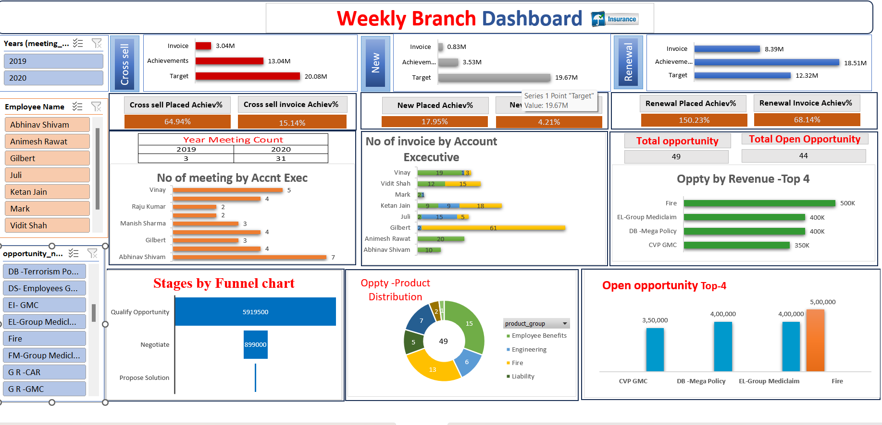
Excel Dashboard

Slide 10
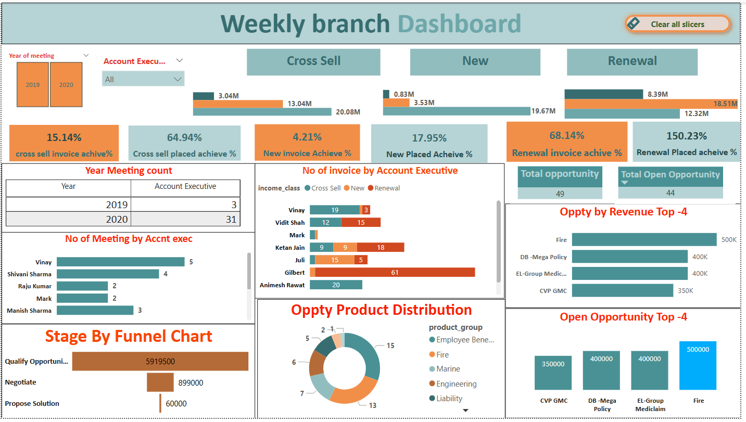
Power BI Dashboard

Slide 11
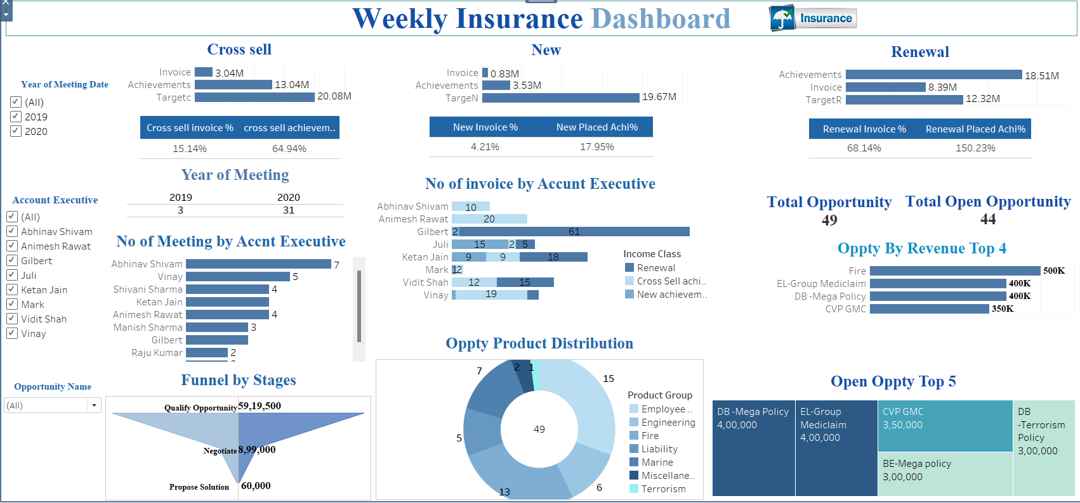
Tableau Dashboard

Slide 12
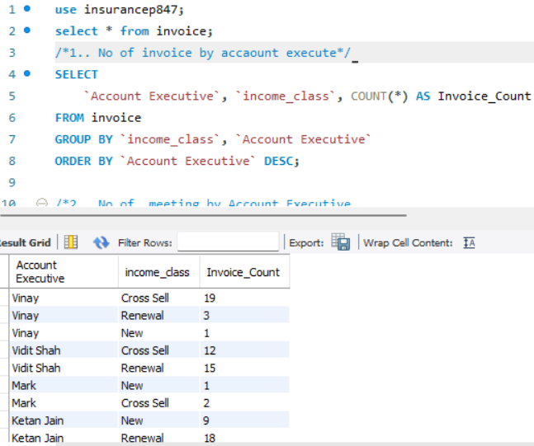
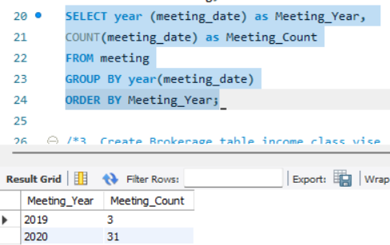
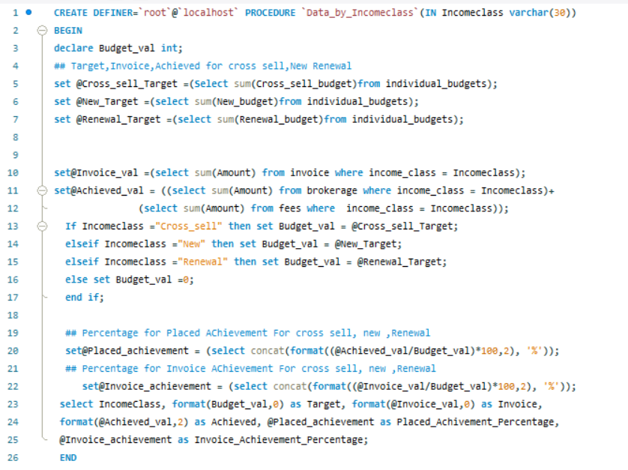
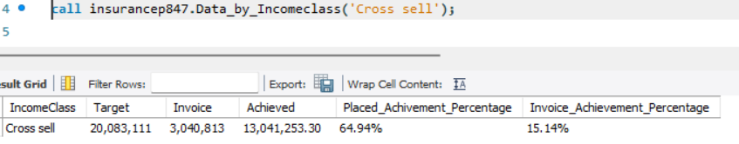
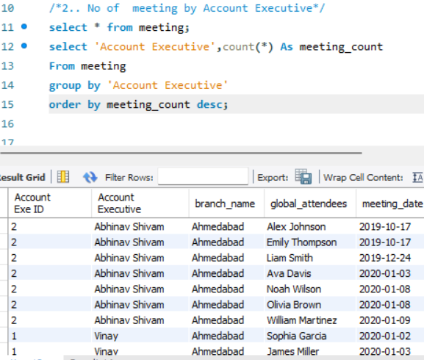
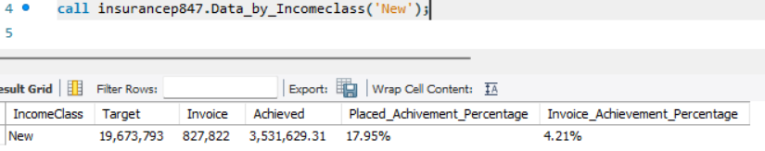
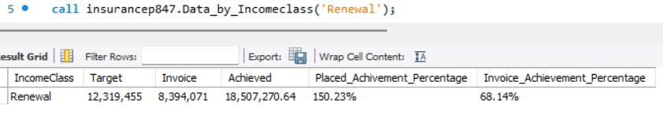
MY SQL

Slide 13
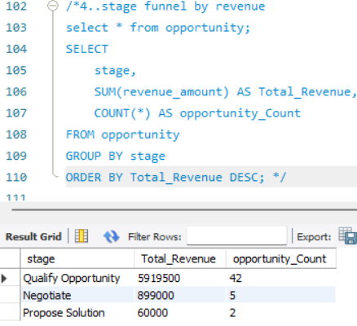
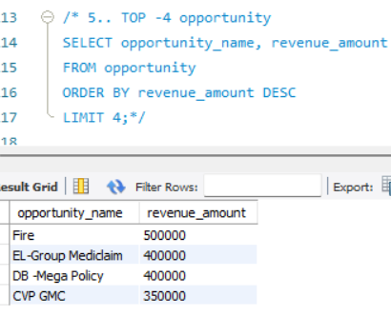
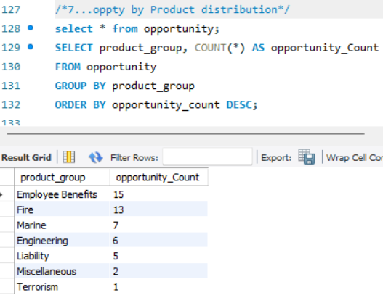
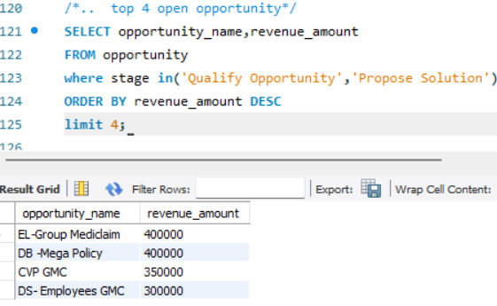
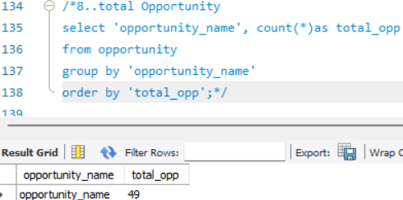
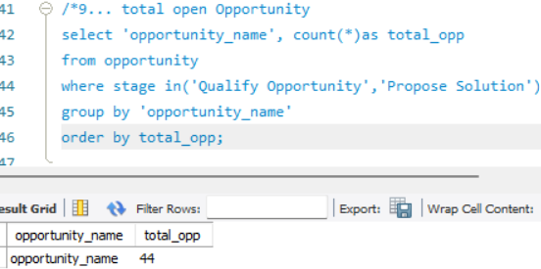
MY SQL

Slide 14
Challenges
Ms Excel :- Offers High layout control but Requires more manual effort for interactivity , there are no kpi card available so do most visualization task manually.
MY SQL:- Need to convert and clean data into csv format . and also complex data runtime of queries was comparatively long to run complex queries.
Power BI :- supports interactive filtering with slicers but has limited text box customization ,due to large data loading performance low of the Dashboard.
Tableau:- Limited charts Feature Available for Free Versions. facing some Kpi alignment problem on dashboard setting.

Slide 15
Conclusion
New Policies
Steady growth with a decent profit margin. Need to focus on increasing the growth rate
Target: 19.67M
Invoice: 0.83 M
Achievement: 3.53M
Placed Achievement: 17.95%
Invoice Achievement: 4.21%
Cross-Sell Policies
High profitability and significant growth. Continue leveraging cross-selling opportunities.
Target: 20.08M
Invoice: 30.4M
Achievement: 13.04M
Placed Achievement: 64.94%
Invoice Achievement: 15.14%
Renewal Policies
Exceptional performance in renewals with very high profitability and growth. Maintain this strong focus
Target: 12.32M
Invoice: 8.39M
Achievement: 18.51M
Placed Achievement: 150.23%
Invoice Achievement: 68.14%

